Slide 1

The Church-Turing Thesis
Chapter 18

Slide 2
Can We Do Better?
FSM ⇒ PDA ⇒ Turing machine
Is this the end of the line?
There are still problems we cannot solve:
● There is a countably infinite number of Turing machines
since we can lexicographically enumerate all the strings
that correspond to syntactically legal Turing machines.
● There is an uncountably infinite number of languages over
any nonempty alphabet.
● So there are more languages than there are Turing machines. But can we do better by creating some new formalism?
Restate the question:
● Is there any computational algorithm that cannot be implemented by Turing machine? Then, if there is, can we find some more powerful model in which we could implement that algorithm?

Slide 3
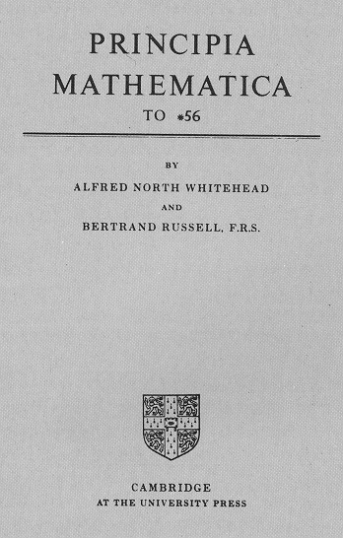
What Can Algorithms Do?
During 1st third of 20th century, a group of influential mathematicians focused on developing a completely formal basis for mathematics
  Principia Mathematica (Whitehead and Russell 1920), most influential work on logic ever
  Hibert’s program (David Hibert), to find a complete and consistent set of axioms for all of mathematics
The continuation and ultimate success of this line of work depended on positive answers to two key questions:
1. Can we make all true statement theorems?
2. Can we decide whether a statement is a theorem?

Slide 4
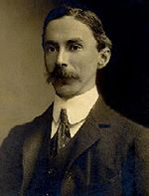
Bertrand Russell (1872 – 1970)
English philosopher, logician, mathematician …
In 1950, awarded Nobel in literature
Russell’s family, one of the most influential in England, politically, land-owning, Earl, Duke, Baron, prime minister
Has a (even more) famous student, Ludwig Wittgenstein
The two are widely referred to as the greatest philosophers of last century
Russell’s paradox: showed that the naive set theory leads to a contradiction.
A set containing exactly the sets that are not members of themselves
One applied version: Barber paradox
A barber shaves all and only those men in town who do not shave themselves.
  whether the barber should shave himself or not?
Applications:
  By Kurt Gödel, in incompleteness theorem by formalizing the paradox
  By Turing, in undecidability of the Halting problem (and with that the Entscheidungsproblem) by using the same trick
Notes:
Entscheidungsproblem: german for decision problem. posed by David Hilbert in 1928. The Entscheidungsproblem asks for an algorithm that will take as input a description of a formal language and a mathematical statement in the language and produce as output either "True" or "False" according to whether the statement is true or false.

Slide 5
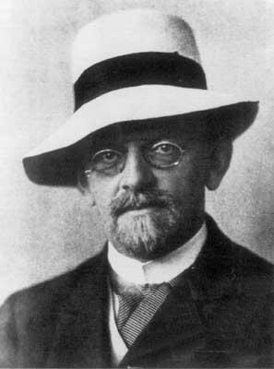
David Hilbert (1862 – 1943)
German mathematician
One of the most influential and universal mathematicians of the 19th and early 20th centuries.
Hibert’s 23 unsolved problems: set the course for much of the mathematical research of the 20th century.
  International Congress of Mathematicians, Paris, 1900
  most successful and deeply considered compilation of open problems ever produced by an individual mathematician
1. Can we make all true statement theorems?
2nd problem. Negative answer by Godel, incompleteness theorems, showing that Hibert’s program to find a complete and consistent set of axioms for all of mathematics is impossible
On his tombstone, one can read his epitaph, the famous lines he had spoken at the end of his retirement address to the society of German Scientists and Physicians in 1930:
We must know.
We will know.
The day before, Godel, in a joint conference, tentatively announced the first expression of his incompleteness theorem, making Hilbert "somewhat angry".
2. Can we decide whether a statement is a theorem?
The Entscheidungsproblem (German: decision problem), 1928.
Negative answer from Alonzo Church and Alan Turing
Notes:
Sipser mentioned Hilbert’s 10th problem: devise an algorithm that tests whether a polynomial has an integral root.
Then Church and Turing went ahead to define what an algorithm is, and then the thesis.
So seems the Problem 2 is related to Hilbert’s 10th problem.

Slide 6
Gödel’s Incompleteness Theorem
Kurt Gödel showed, in the proof of his Incompleteness Theorem [Gödel 1931], that the answer to question 1 is no. In particular, he showed that there exists no decidable axiomatization of Peano arithmetic that is both consistent and complete.
1. Can we make all true statement theorems?
These theorems ended a half-century of attempts, beginning with the work of Frege and culminating in Principia Mathematica and Hilbert's formalism, to find a set of axioms sufficient for all mathematics.
The incompleteness theorems also imply that not all mathematical questions are computable.
Notes:
Debatable:
http://www.cs.bu.edu/fac/lnd/expo/gdl.htm
Cook-Levin theorem

Slide 7
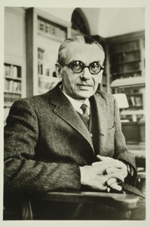
Kurt Gödel
1906 – 1978. One of the greatest logicians of all time
Gödel and Einstein … were known to take long walks together to and from the Institute for Advanced Study. … toward the end of his life Einstein confided that his "own work no longer meant much, that he came to the Institute merely…to have the privilege of walking home with Gödel. "
1947, Einstein … accompanied Gödel to his U.S. citizenship exam, where they acted as witnesses. Gödel had confided in them that he had discovered an inconsistency in the U.S. Constitution, one that would allow the U.S. to become a dictatorship
In later life, suffered periods of mental instability… fear of being poisoned; wouldn't eat unless his wife tasted his food for him. Late in 1977, wife was hospitalized for six months. In her absence, he refused to eat, eventually starving himself to death. He weighed 65 pounds when he died.

Slide 8
The Entscheidungsproblem
  2. Can we decide whether a statement is a theorem?
  Equivalent ways to state the problem:
  Does there exist an algorithm to decide, given an arbitrary sentence w in first order logic, whether w is valid?
  Given a set of axioms A and a sentence w, does there exist an algorithm to decide whether w is entailed by A?
  Given a set of axioms, A, and a sentence, w, does there exist an algorithm to decide whether w can be proved from A?

Slide 9
The Entscheidungsproblem
In 1936 and 1937, Church and Turing published independent papers showing that it is impossible to decide algorithmically whether statements in arithmetic are true or false, and thus a general solution to the Entscheidungsproblem is impossible.
This result is now known as Church's Theorem or the Church–Turing Theorem (not to be confused with the Church–Turing thesis).
To answer the question, in any of these forms, requires formalizing the definition of an algorithm:
  Church: lambda calculus
  Turing: Turing machines
  Turing proved that the two are equivalent.
  Even though algorithms have had a long history in mathematics, the notion of algorithm was not defined precisely before this.

Slide 10
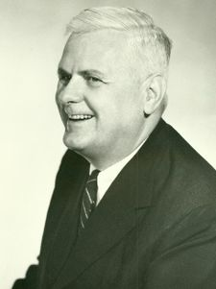
Alonzo Church
American mathematician and logician
major contributions to mathematical logic and foundations of mathematical logic
Church theorem (Church-Turing theorem)
Church thesis (Church-Turing thesis)
lambda calculus
taught at Princeton, 1929–1967
Church's doctoral students were an extraordinarily accomplished lot, including
  Stephen Kleene
  Michael O. Rabin
  Dana Scott
  Alan Turing.
  1903 – 1995
Notes:
Human judge asking questions, to be answered by a human and a machine. If cannot tell the machine from the human, machine passes the test

Slide 11
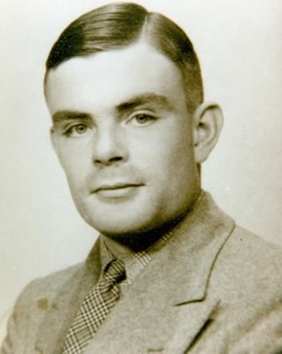
Alan Turing
One of the 100 Most Important People of the 20th Century
  For his role in the creation of the modern computer
  "The fact remains that everyone who taps at a keyboard, opening a spreadsheet or a word-processing program, is working on an incarnation of a Turing machine."
Turing machine, influential formalization of the concept of the algorithm and computation
Turing test, influential in AI
  1912 – 1954
1936 – 1938, PhD, Princeton, under Alonzo Church
Then, back to Cambridge, attended lectures by Ludwig Wittgenstein
about the foundations of mathematics.
  Ludwig Wittgenstein, student of Bertrand Russell at Cambridge, the two are widely referred to as the greatest philosophers of last century
Notes:
Human judge asking questions, to be answered by a human and a machine. If cannot tell the machine from the human, machine passes the test

Slide 12
Church's Thesis
(Church-Turing Thesis)
All formalisms powerful enough to describe everything we think of as a computational algorithm are equivalent.
Implication: we should not expect to find some other reasonable computational model that is more powerful
  that can solve problems not solvable by Turing machines
  that would provide positive answers to the 2 questions
Profound philosophical implications
This isn’t a formal statement, so we can’t prove it. But today the thesis has near-universal acceptance.
  Many different computational models have been proposed and they all turn out to be equivalent.

Slide 13
The Church-Turing Thesis
Examples of equivalent formalisms:
● Modern computers (with unbounded memory)
● Lambda calculus
● Partial recursive functions
● Tag systems (FSM plus FIFO queue)
● Unrestricted grammars:
aSa → B
● Post production systems
● Markov algorithms
● Conway’s Game of Life
● One dimensional cellular automata
● DNA-based computing
● Lindenmayer systems

Slide 14
The Unsolvability of the Halting Problem
Chapter 19

Slide 15
What We Can Compute
  ● Until a bit before the middle of the 20th century, western mathematicians believed that it would eventually be possible to prove any true mathematical statement, and to define an algorithm to solve any clearly stated mathematical problem
  ● Had they been right, our work would be done.
  ● But, they were wrong. There are well-defined problems for which no Turing machine exists.
  ● According to Church-Turing thesis, no other formalism is more powerful than Turing machines.
  ● Now, prove one of the most philosophically important theorems of the theory of computation: There is a specific problem (halting problem) that is algorithmically unsolvable.
  ● demonstrates that computers are limited in a fundamental way
  ● shows the limits of what we can compute

Slide 16
Languages and Machines
SD
D
Context-Free
Languages
Regular
Languages
reg exps
FSMs
cfgs
PDAs
unrestricted grammars
Turing Machines
Recursively enumerable
Recursive

Slide 17
D and SD
  ● A TM M with input alphabet Σ decides a language L ⊆ Σ* iff,
  for any string w ∈ Σ*,
    ● if w ∈ L then M accepts w, and
    ● if w ∉ L then M rejects w.
  A language L is decidable (in D) iff there is a Turing
  machine M that decides it.
  ● A TM M with input alphabet Σ semidecides L iff for any string
  w ∈ Σ*,
    ● if w ∈ L then M accepts w
    ● if w ∉ L then M does not accept w. M may reject or loop.
  A language L is semidecidable (in SD) iff there is a Turing
  machine that semidecides it.

Slide 18
The Language H
H = {<M, w> : TM M halts on input string w}
Theorem: The language:
H = {<M, w> : TM M halts on input string w}
● H is easy to state and understand.
● Of great practical importance since a program to decide H could be a very useful part of a program-correctness checker
● is semidecidable, but
● is not decidable

Slide 19
3x + 1 Problem
Does times3 always halt?
times3(x: positive integer) =
While x ≠ 1 do:
If x is even then x = x/2.
Else x = 3x + 1
25
76
38
19
58
29
88
44
22
11
34
17
52
26
13
40
20
10
5
16
8
4
2
1
It is conjectured that, for any positive integer, times3 halts. But so far, no proof, no counterexample.
So there appear to be programs whose halting behavior is difficult to determine

Slide 20
H is Semidecidable
Lemma: The language:
H = {<M>, w : TM M halts on input string w}
is semidecidable.
Proof: The TM M_{SH} semidecides H:
M_{SH}(<M, w>) =
1. Run M on w.
M_{SH} halts iff M halts on w. Thus M_{SH} semidecides H.
M_{SH} is a universal Turing machine

Slide 21
The Unsolvability of the Halting Problem
Lemma: The language:
H = {<M, w> : TM M halts on input string w}
is not decidable.
Proof: We assume H is decidable and obtain a contradiction. Suppose M_{H} is a decider for H. Then M_{H} would implement the specification:
M_{H}(<M: string, w: string>) = If M halts on input w accept
Else reject

Slide 22
M_{D}
Now we construct a new TM M_{D} with M_{H} as a subroutine.
M_{D} calls M_{H} to determine what M does when the input to M is its own description <M>.
Once M_{D} has determined this information, it does the opposite.
M_{D}(<M>) = if M_{H}(<M>, <M>) accepts loop forever
else halt
M_{H}(<M>, <M>) accepts = M halts, so to make it more straightforward,
M_{D}(<M>) = if M halts loop forever
else halt
Note, we are able to construct M_{D} that does the opposite of M depends on the existence of M_{H}, that is, H is decidable.
Now, what happens of we run M_{D} with <M_{D}> ?
M_{D}(< M_{D} >) = if M_{D} halts loop forever
else halt
Contradiction established.

Slide 23
Recall Russell’s Paradox
A set containing exactly the sets that are not members of themselves.
A barber shaves all and only those men in town who do not shave themselves.
When one thinks about whether the barber should shave himself or not, the paradox begins to emerge.
Russell’s paradox shows the undecidability of the membership of an arbitrary set.
The same trick is used to show H is not decidable.

Slide 24
Viewing the Halting Problem as Diagonalization
● Lexicographically enumerate Turing machines.
● Let 1 mean halting, blank mean non halting.
● If we claim that M_{H} exists, we are claiming that it can compute the correct value for any cell in this table on demand.
● M_{D} computes the opposite of the diagonal entries:
What value should occur in ?
Contradiction arises as the entry must be the opposite of itself !
 | i₁ | i₂ | i₃ | … | <M_{D}> | …
machine₁ | 1
machine₂ |  | 1
machine₃ |  |  |  |  | 1
… |  |  |  | 1
M_{D} |  |  | 1 |  | ? | 1
… | 1 | 1 | 1
… |  |  |  | 1
M_{D} |  |  | 1 |  | ? | 1

Slide 25
Undecidability of the Halting Problem
To show the Halting Problem can't be algorithmically solved,
We use diagonalization, a proof method that's evolved
Where Turing Machines are asked to run in modes of simulation,
On codes that represent themselves, an auto-copulation.
Suppose a TM we'll call Halt, with input that's a code //we use M_{H}
Of another machine M, and in addition is showed
An input x to M, whence Halt says (and it's always right)
Whether M did halt on x. (But how? Divine insight?)
Let TM D, with input that's the code of machine A //we use M_{D}
Use Halt to find if A will halt on its own code, then say,
``If the answer's `no' I'll output 1, else fight the urge
To give another answer''-- better then that D diverge.
Rather than recount the proof's denouement, we'll be prudent,
And leave the rest to you, dear reader, the ever-able student.
When Halt is given the code of D, it simply cannot know
If D does halt on its own code--but that's for you to show.
The trick is to diagonalize--D changed the bit returned
By Halt, thus contradicts its work, as its output is spurned.
No matter how a TM solves the Halting Problem, see,
Diagonalization makes a counter-example. Q.E.D.
Notes:
Martin Cohn
Harry Mairson
Computer Science Department
Brandeis University

Slide 26
Implications of the Undecidability of H
H is far more than an anomaly. It is the key to the fundamental distinction between the classes D and SD
Theorem: If H were in D then every SD language would be in D.
Proof: Let L be any SD language. There exists a TM M_{L} that
semidecides it.
If H were also in D, then there would exist an O that decides it.
To decide whether w is in L(M_{L}):
M'(w: string) =
1. Run O on <M_{L}, w>.
2. If O accepts (i.e., M_{L} will halt), then:
  2.1. Run M_{L} on w.
  2.2. If it accepts, accept. Else reject.
3. Else reject.
So, if H were in D, all SD languages would be.

Slide 27
Back to the Entscheidungsproblem
Having defined the Turing machine, Turing went on to show the unsolvability of the halting problem. He then used that result to show the unsolvability of the Entscheidungsproblem.
Theorem: The Entscheidungsproblem is unsolvable.
Proof: (Due to Turing)
1. If we could solve the problem of determining whether a given Turing
machine ever prints the symbol 0, then we could solve the problem of
determining whether a given Turing machine halts.
2. But we can’t solve the problem of determining whether a given Turing
machine halts, so neither can we solve the problem of determining
whether it ever prints 0.
3. Given a Turing machine M, we can construct a logical formula F that is
true iff M ever prints the symbol 0.
4. If there were a solution to the Entscheidungsproblem, then we would
be able to determine the truth of any logical sentence, including F and
thus be able to decide whether M ever prints the symbol 0.
5. But we know that there is no procedure for determining whether M
ever prints 0.
6. So there is no solution to the Entscheidungsproblem.

Slide 28
Prove by Reduction
This proof is an example of the reduction technique
Used extensively to show undecidability of problems (ch21)
Reduce an old problem known not in D to a new problem with unknown decidability
If the new problem is in D, that is, decidable by some M, we can use M as the basic for a procedure to decide the old problem.
But since we know the old problem is not in D, contradiction, so the new problem cannot be in D.

Slide 29
Decidable and Semidecidable Languages
Chapter 20

Slide 30
D and SD Languages
SD
D
Context-Free
Languages
Regular
Languages

Slide 31
Every CF Language is in D
  Theorem: The set of context-free languages is a proper subset of D.
  Proof:
  ● Every context-free language is decidable, so the context-
  free languages are a subset of D.
  ● There is at least one language, A^{n}B^{n}C^{n}, that is decidable
  but not context-free.
  So the context-free languages are a proper subset of D.

Slide 32
Decidable and Semidecidable Languages
Almost every obvious language that is in SD is also in D:
● A^{n}B^{n}C^{n} = {a^{n}b^{n}c^{n}, n ≥ 0}
● {wcw, w ∈ {a, b}*}
● {ww, w ∈ {a, b}*}
● {w = x∗y=z: x,y,z ∈ {0, 1}* and, when x, y, and z are viewed
as binary numbers, xy = z}
But there are languages that are in SD but not in D:
● H = {<M, w> : M halts on input w}
● L = {w: w is the email address of someone who will respond to a message you just posted to your newsgroup}
If someone responds, you know his email address is in L. Others, you don’t know, all you can do is to wait.

Slide 33
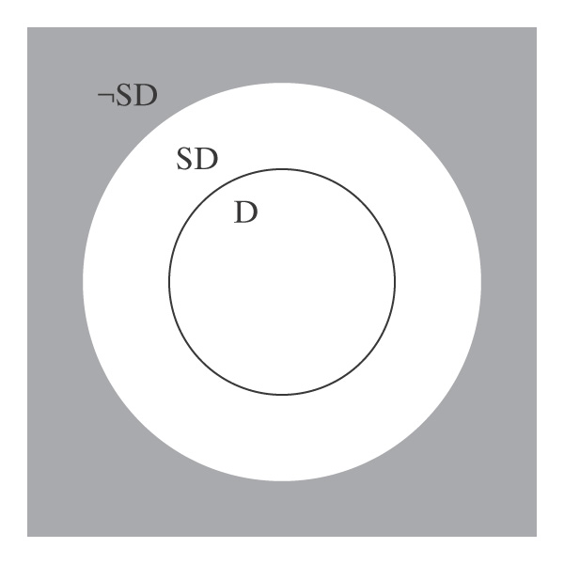
D and SD
D is a subset of SD. In other words, every decidable language is also semidecidable.
There exists at least one language that is in SD/D, the donut in the picture.
There exist languages that are not in SD. In other words, the gray area of the figure is not empty.

Slide 34
Languages That Are Not in SD
Theorem: 3. There are languages that are not in SD.
Proof: Assume any nonempty alphabet Σ.
Lemma: There is a countably infinite number of SD languages over Σ.
Proof:
Lemma: There is an uncountably infinite number of languages over Σ.
So there are more languages than there are languages in SD. Thus there must exist at least one language that is in ¬SD.

Slide 35
Closure Under Complement
Regular languages are closed under complement.
Context free languages are not.
How about D and SD?
Theorem: The set D is closed under complement.
Proof: (by construction) …
Theorem: The set SD is not closed under complement.

Slide 36
D and SD Languages
Theorem: A language is in D iff both it and its complement are in SD.
Proof:
● L in D implies L and ¬L are in SD:
● L is in SD because D ⊂ SD.
● D is closed under complement
● So ¬L is also in D and thus in SD.
● L and ¬L are in SD implies L is in D:
● M₁ semidecides L.
● M₂ semidecides ¬L.
● To decide L:
● Run M₁ and M₂ in parallel on w.
● Exactly one of them will eventually accept.

Slide 37
A Language that is Not in SD
Theorem: The language ¬H =
{<M, w> : TM M does not halt on input string w}
is not in SD.
Proof:
● H is in SD.
● If ¬H were also in SD then H would be in D.
● But H is not in D.
● So ¬H is not in SD.

Slide 38
Enumeration a Language
So far, we have defined a language by specifying either a grammar that can generate it or a machine that can accept it.
But it’s also possible to specify a machine that is a generator.
Enumerate means list.
We say that Turing machine M enumerates the language L iff, for some fixed state p of M:
L = {w : (s, ε) |-_{M}* (p, w)}.
A language is Turing-enumerable iff there is a Turing machine that enumerates it.

Slide 39
Turing Enumerable = SD
Theorem: A language is SD iff it is Turing-enumerable.

Slide 40
Lexicographic Enumeration
M lexicographically enumerates L iff M enumerates the elements of L in lexicographic order.
A language L is lexicographically Turing-enumerable iff there is a Turing machine that lexicographically enumerates it.
Example: A^{n}B^{n}C^{n} = {a^{n}b^{n}c^{n} : n ≥ 0}
Lexicographic enumeration:

Slide 41
Lexicographically Enumerable = D
Theorem: A language is in D iff it is lexicographically Turing-enumerable.

Slide 42
Language Summary
IN SD ¬H OUT
Semideciding TM H Reduction
Enumerable
Unrestricted grammar
D
Deciding TM A^{n}B^{n}C^{n} Diagonalize
Lexic. enum Reduction
L and ¬L in SD
Context-Free
CF grammar A^{n}B^{n} Pumping
PDA Closure
Closure
Regular
Regular Expression a*b* Pumping
FSM Closure

Slide 43
Decidability and Undecidability Proofs
Sections 21.1 – 21.3

Slide 44
Some Undecidable Problems
(Languages That Aren’t In D)
The Problem View | The Language View
Does TM M halt on w? | H = {<M, w> : M halts on w}
Does TM M not halt on w? | ¬H = {<M, w> : M does not halt on w}
Does TM M halt on the empty tape? | H_{ε} = {<M> : M halts on ε}
Is there any string on which TM M halts? | H_{ANY} = {<M> : there exists at least one string on which TM M halts }
Does TM M accept all strings? | A_{ALL} = {<M> : L(M) = Σ*}
Do TMs M_{a} and M_{b} accept the same languages? | EqTMs = {<M_{a}, M_{b}> : L(M_{a}) = L(M_{b})}
Is the language that TM M accepts regular? | TMreg = {<M>:L(M) is regular}

Slide 45
Reduction is Ubiquitous
  ● Calling Jen
  Call Jen
  Get hold of Jim
Reduce a problem P_{old} to another (simpler) problem P_{new} . The solution to P_{new} can be used to build a solution for P_{old}.
Usage 1: Known solution to P_{new}, obtain a solution for P_{old}.
Usage 2: Known insolvability of P_{old}, prove insolvability of P_{new}.
Prove by contradiction: if P_{new} were solvable, we can use its solution to build a solution for P_{old}. But P_{old} is not solvable, so P_{new} can’t be solvable.

Slide 46
Using Reduction for Undecidability
A reduction R from L_{old} to L_{new} consists of one or more Turing machines such that:
If there exists a Turing machine Oracle that decides (or
semidecides) L_{new}, then the Turing machines in R can be
composed with Oracle to build a deciding (or a
semideciding) Turing machine for L_{old}.
P_{old} ≤ P_{new} means that P_{old} is reducible to P_{new} .
Focus on 1 for now
1. Known P_{old} is not in D, we can show P_{new} is not in D
2. Known P_{old} is not in SD, we can show P_{new} is not in SD
For both, no need to care about the efficiency of R.
Can also be used in complexity to show NP-hardness:
3. Known P_{old} is NP-hard, we can show P_{new} is NP-hard
Need to care about the efficiency of R.

Slide 47
Using Reduction for Undecidability
(R is a reduction from L_{old} to L_{new} ) ∧ (L_{new} is in D) → (L_{old} is in D)
If (L_{old} is in D) is false, then at least one of the two antecedents of that implication must be false. So:
If (R is a reduction from L_{old} to L_{new}) is true,
then (L_{new} is in D) must be false.

Slide 48
To Use Reduction for Undecidability
1. Choose a language L_{old}:
  ● that is already known not to be in D, and
  ● that can be reduced to L_{new} (i.e., there can be a deciding machine for L_{old} if there existed a deciding machine for L_{new} ), and the reduction is as straightforward as possible.
2. Define the reduction R.
3. Describe the composition C of R with Oracle (the machine that hypothesize decides L_{new} ).
4. Show that C does correctly decide L_{old} if Oracle exists. We
do this by showing:
● R can be implemented by Turing machines,
● C is correct:
● If x ∈ L_{old}, then C(x) accepts, and
● If x ∉ L_{old}, then C(x) rejects.

Slide 49
Mapping Reductions
The most straightforward way of reduction is to transform instances of L_{old} into instances of L_{new} .
L_{old} is mapping reducible to L_{new} (L_{old} ≤_{M} L_{new}) iff there exists
some computable function f such that:
∀x∈Σ* (x ∈ L_{old} ↔ f(x) ∈ L_{new} ).
To decide whether x is in L_{old}, we transform it, using f,
into a new object and ask whether that object is in L_{new}.
If L_{old} ≤_{M} L_{new}, C(x) = Oracle(R(x)) will decide L_{old}
Notes:
Mapping reducibility: also called many-one reducibility

Slide 50
Important Elements in a Reduction Proof
A clear declaration of the reduction “from” and “to” languages.
A clear description of R.
If R is doing anything nontrivial, argue that it can be implemented as a TM.
Note that machine diagrams are not necessary or even sufficient in these proofs. Use them as thought devices, where needed.
Run through the logic that demonstrates how the “from” language is being decided by the composition of R and Oracle. You must do both accepting and rejecting cases.
Declare that the reduction proves that your “to” language is not in D.

Slide 51
The Most Common Mistake:
Doing the Reduction Backwards
The right way to use reduction to show that L_{new} is not in D:
1. Given that L_{old} is not in D, L_{old}
2. Reduce L_{old} to L_{new} , i.e., show how to solve L_{old}
(the known one) in terms of L_{new} (the unknown one) L_{new}
Doing it wrong by reducing L_{new} (the unknown one) to L_{old}):
If there exists a machine M₁ that solves H, then we could build a
machine that solves L_{new} as follows:
1. Return (M₁(<M, ε>)).
This proves nothing. It’s an argument of the form:
If False then …

Slide 52
H_{ANY} = {<M> : there exists at least one string on which TM M halts}
Theorem: H_{ANY} is in SD.
Proof: by exhibiting a TM T that semidecides it.
What about simply trying all the strings in Σ* one at a time
until one halts?

Slide 53
H_{ANY} is in SD
T(<M>) =
1. Use dovetailing to try M on all of the elements of Σ*:
ε [1]
ε [2] a [1]
ε [3] a [2] b [1]
ε [4] a [3] b [2] aa [1]
ε [5] a [4] b [3] aa [2] ab [1]
ε [6] a [5] aa [3] ab [2] ba [1]
2. If any instance of M halts, halt and accept.
T will accept iff M halts on at least one string. So T
semidecides H_{ANY.}
Notes:
P442, dovetailing.
Row by row, left to right.
In our case, can stop at b [3]

Slide 54
H_{ANY} is not in D
H = {<M, w> : TM M halts on input string w}
R
(?Oracle) H_{ANY} = {<M> : there exists at least one string on which TM M halts}
R(<M, w>) =
1. Construct <M#>, where M#(x) operates as follows:
  1.1. Examine x.
  1.2. If x = w, run M on w, else loop.
2. Return <M#>.
If Oracle exists, then C = Oracle(R(<M, w>)) decides H:
● R can be implemented as a Turing machine.
● C is correct: The only string on which M# can halt is w. So:
● <M, w> ∈ H: M halts on w. So M# halts on w. There exists at least on
string on which M# halts. Oracle(<M#>)accepts.
● <M, w> ∉ H: M does not halt on w, so neither does M#. So there exists
no string on which M# halts. Oracle(<M#>) rejects.
But no machine to decide H can exist, so neither does Oracle.

Slide 55
(Another R That Works)
Proof: We show that H_{ANY} is not in D by reduction from H:
H = {<M, w> : TM M halts on input string w}
R
(?Oracle) H_{ANY} = {<M> : there exists at least one string on which TM M
halts}
R(<M, w>) =
1. Construct the description <M#>, where M#(x) operates as follows:
  1.1. Erase the tape.
  1.2. Write w on the tape.
  1.3. Run M on w.
2. Return <M#>.
If Oracle exists, then C = Oracle(R(<M, w>)) decides H:
● C is correct: M# ignores its own input. It halts on everything or nothing. So:
● <M, w> ∈ H: M halts on w, so M# halts on everything. So it halts on at
least one string. Oracle(<M#>) accepts.
● <M, w> ∉ H: M does not halt on w, so M# halts on nothing. So it does not
halt on at least one string. Oracle(<M#>) rejects.
But no machine to decide H can exist, so neither does Oracle.

Slide 56
Decidability and Undecidability Proofs
Sections 21.4 - 21.7

Slide 57
Is There a Pattern?
  ● Does L contain some particular string w?
  ● Does L contain ε?
  ● Does L contain any strings at all?
  ● Does L contain all strings over some alphabet Σ?
  ● A = {<M, w> : TM M accepts w}.
  ● A_{ε} = {<M> : TM M accepts ε}.
  ● A_{ANY} = {<M> : there exists at least one string that
  TM M accepts}.
  ● A_{ALL} = {<M> : TM M accepts all inputs}.

Slide 58
Rice’s Theorem
  No nontrivial property of the SD languages is decidable.
  or
  Any language that can be described as:
  {<M>: P(L(M)) = True}
  for any nontrivial property P, is not in D.
  A nontrivial property is one that is not simply:
  True for all languages, or
  False for all languages.

Slide 59
Applying Rice’s Theorem
To use Rice’s Theorem to show that a language L is not in D we must:
● Specify property P.
● Show that the domain of P is the SD languages.
● Show that P is nontrivial:
● P is true of at least one language
● P is false of at least one language

Slide 60
Applying Rice’s Theorem
1. {<M> : L(M) contains only even length strings}.
2. {<M> : L(M) contains an odd number of strings}.
3. {<M> : L(M) contains all strings that start with a}.
4. {<M> : L(M) is infinite}.
5. {<M> : L(M) is regular}.
6. {<M> : M contains an even number of states}.
7. {<M> : M has an odd number of symbols in its tape
alphabet}.
8. {<M> : M accepts ε within 100 steps}.
9. {<M>: M accepts ε}.
10. {<M_{a}, M_{b}> : L(M_{a}) = L(M_{b})}.

Slide 61
Given a TM M, is L(M) Regular?
The problem: Is L(M) regular?
As a language: Is {<M> : L(M) is regular} in D?
No, by Rice’s Theorem:
● P = True if L is regular and False otherwise.
● The domain of P is the set of SD languages since it is
the set of languages accepted by some TM.
● P is nontrivial:
  ♦ P(a*) = True.
  ♦ P(A^{n}B^{n}) = False.

Slide 62
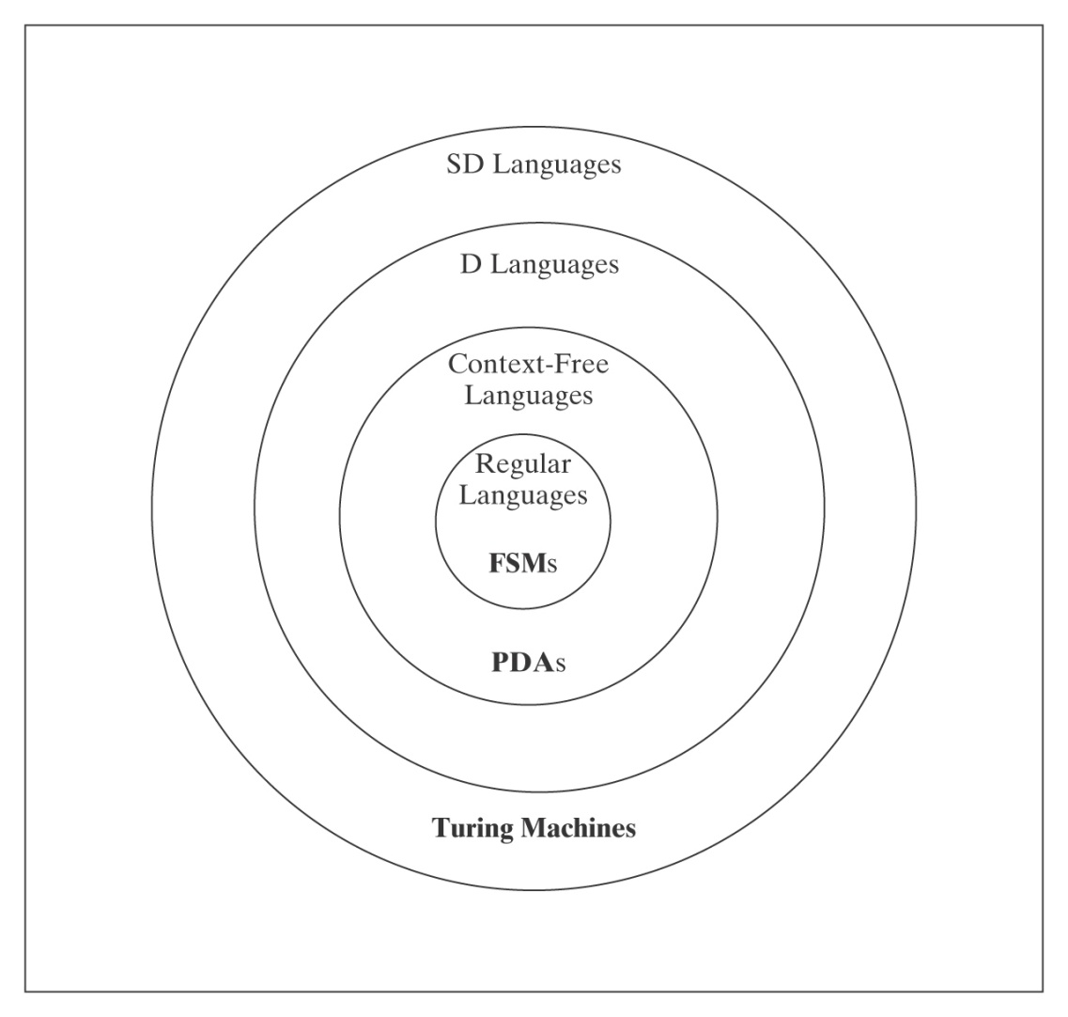
Non-SD Languages
There is an uncountable number of non-SD languages, but only a
countably infinite number of TM’s (hence SD languages). ∴The class
of non-SD languages is much bigger than that of SD languages!

Slide 63
Non-SD Languages
Intuition: Non-SD languages usually involve either infinite
search or knowing a TM will infinite loop.
Examples:
¬H = {<M, w> : TM M does not halt on w}.
{<M> : L(M) = Σ*}.
{<M> : TM M halts on nothing}.

Slide 64
Proving Languages are not SD
● Contradiction
● L is the complement of an SD/D Language.
● Reduction from a known non-SD language

Slide 65
The Compliment of L is in SD/D
Suppose we want to know whether L is in SD and we know:
● ¬L is in SD, and
● At least one of L or ¬L is not in D.
Then we can conclude that L is not in SD, because, if it were,
it would force both itself and its complement into D, which we
know cannot be true.
Example:
● ¬H (since ¬(¬H) = H is in SD and not in D)

Slide 66
H_{¬ANY}
Theorem: H_{¬ANY} = {<M> : there does not exist any string on which TM M halts} is not in SD.
Proof: ¬H_{¬ANY} is H_{ANY} =
{<M> : there exists at least one string on which TM M
halts}.
We already know:
● ¬H_{¬ANY} is in SD.
● ¬H_{¬ANY} is not in D.
So H_{¬ANY} is not in SD because, if it were, then H_{ANY} would be in D but it isn’t.

Slide 67
Using Reduction
Theorem: If there is a reduction R from L_{old} to L_{new} and L_{old} is not SD, then L_{new} is not SD.
So, we must:
Choose a language L_{old} that is known not to be in SD.
Hypothesize the existence of a semideciding TM Oracle.
Note: R may not swap accept for loop.

Slide 68
H_{ALL} = {<M> : TM halts on Σ*}
What about: ¬H = {<M, w> : TM M does not halt on w}
R
(?Oracle) H_{ALL} = {<M> : TM halts on Σ*}
Reduction Attempt 1: R(<M, w>) =
1. Construct the description <M#>, where M#(x)
operates as follows:
  1.1. Erase the tape.
  1.2. Write w on the tape.
  1.3. Run M on w.
2. Return <M#>.

Slide 69
There May Be No Easy Way to Flip
¬H = {<M, w> : TM M does not halt on w}
R
(?Oracle) H_{ALL} = {<M> : TM halts on Σ*}
Reduction Attempt 1: R(<M, w>) =
1. Construct the description <M#>, where M#(x) operates as follows:
  1.1. Erase the tape.
  1.2. Write w on the tape.
  1.3. Run M on w.
2. Return <M#>.
If Oracle exists, C = Oracle(R(<M, w>)) semidecides ¬H:
● <M, w> ∈ ¬H: M does not halt on w, so M# gets stuck in step 1.3
and halts on nothing. Oracle does not accept.
● <M, w> ∉ ¬H: M halts on w, so M# halts on everything. Oracle
accepts.

Slide 70
H_{ALL} = {<M> : TM halts on Σ*}
R(<M, w>) reduces ¬H to H_{ALL}:
1. Construct the description <M#>, where M#(x) operates as follows:
  1.1. Copy the input x to another track for later.
  1.2. Erase the tape.
  1.3. Write w on the tape.
  1.4. Run M on w for |x| steps or until M naturally halts.
  1.5. If M naturally halted, then loop.
  1.6. Else halt.
2. Return <M#>.
If Oracle exists, C = Oracle(R(<M, w>)) semidecides ¬H:
● <M, w> ∈ ¬H: No matter how long x is, M will not halt in |x|
steps. So, for all inputs x, M# makes it to step 1.6. So it
halts on everything. Oracle accepts.
● <M, w> ∉ ¬H: M halts on w in n steps. On inputs
of length less than n, M# makes it to step 1.6 and halts.
But on all inputs of length n or greater, M# will loop in step
1.5. Oracle does not accept.

Slide 71
The Problem View | The Language View | Status
Does TM M have an even number of states? | {<M> : M has an even number of states} | D
Does TM M halt on w? | H = {<M, w> : M halts on w} | SD/D
Does TM M halt on the empty tape? | H_{ε} = {<M> : M halts on ε} | SD/D
Is there any string on which TM M halts? | H_{ANY} = {<M> : there exists at least one string on which TM M halts } | SD/D
Does TM M halt on all strings? | H_{ALL} = {<M> : M halts on Σ*} | ¬SD
Does TM M accept w? | A = {<M, w> : M accepts w} | SD/D
Does TM M accept ε? | A_{ε} = {<M> : M accepts ε} | SD/D
Is there any string that TM M accepts? | A_{ANY} {<M> : there exists at least one string that TM M accepts } | SD/D

Slide 72
Does TM M accept all strings? | A_{ALL} = {<M> : L(M) = Σ*} | ¬SD
Do TMs M_{a} and M_{b} accept the same languages? | EqTMs = {<M_{a}, M_{b}> : L(M_{a}) = L(M_{b})} | ¬SD
Does TM M not halt on any string? | H_{¬ANY} = {<M> : there does not exist any string on which M halts} | ¬SD
Does TM M not halt on its own description? | {<M> : TM M does not halt on input <M>} | ¬SD
Is TM M minimal? | TM_{MIN} = {<M>: M is minimal} | ¬SD
Is the language that TM M accepts regular? | TMreg = {<M> : L(M) is regular} | ¬SD
Does TM M accept the language A^{n}B^{n}? | A_{anbn} = {<M> : L(M) = A^{n}B^{n}} | ¬SD

Slide 73
Language Summary
IN SD ¬H OUT
Semideciding TM H Reduction
Enumerable
Unrestricted grammar
D
Deciding TM A^{n}B^{n}C^{n} Diagonalize
Lexic. enum Reduction
L and ¬L in SD
Context-Free
CF grammar A^{n}B^{n} Pumping
PDA Closure
Closure
Regular
Regular Expression a*b* Pumping
FSM Closure

